Slide 1
Today’s Topics
What is Optimization?
Types of Optimization
1. Gradient Descecnt Algorithm
2. Stochastic Gradient Descecnt Algorithm
The Backpropagation Algorithm
The Feed Forwarding Algorithm
2

Slide 2
It is the process of finding those inputs on which function gives best result or gives maximum accuracy.
Optimization
Simple Term
In Machine learning Term
It is the process where we train the model iteratively that results in a maximum and minimum function evaluation.

Slide 3
To get an accurate model with less error rate.
Why and how we do Optimization?
Why ?
How ?
We compare the result after every iteration by changing hyperparameters. Such parameters which we set before the learning process begins called Hyperparmeters. e.g epochs , no_of_iteration,etc.

Slide 4
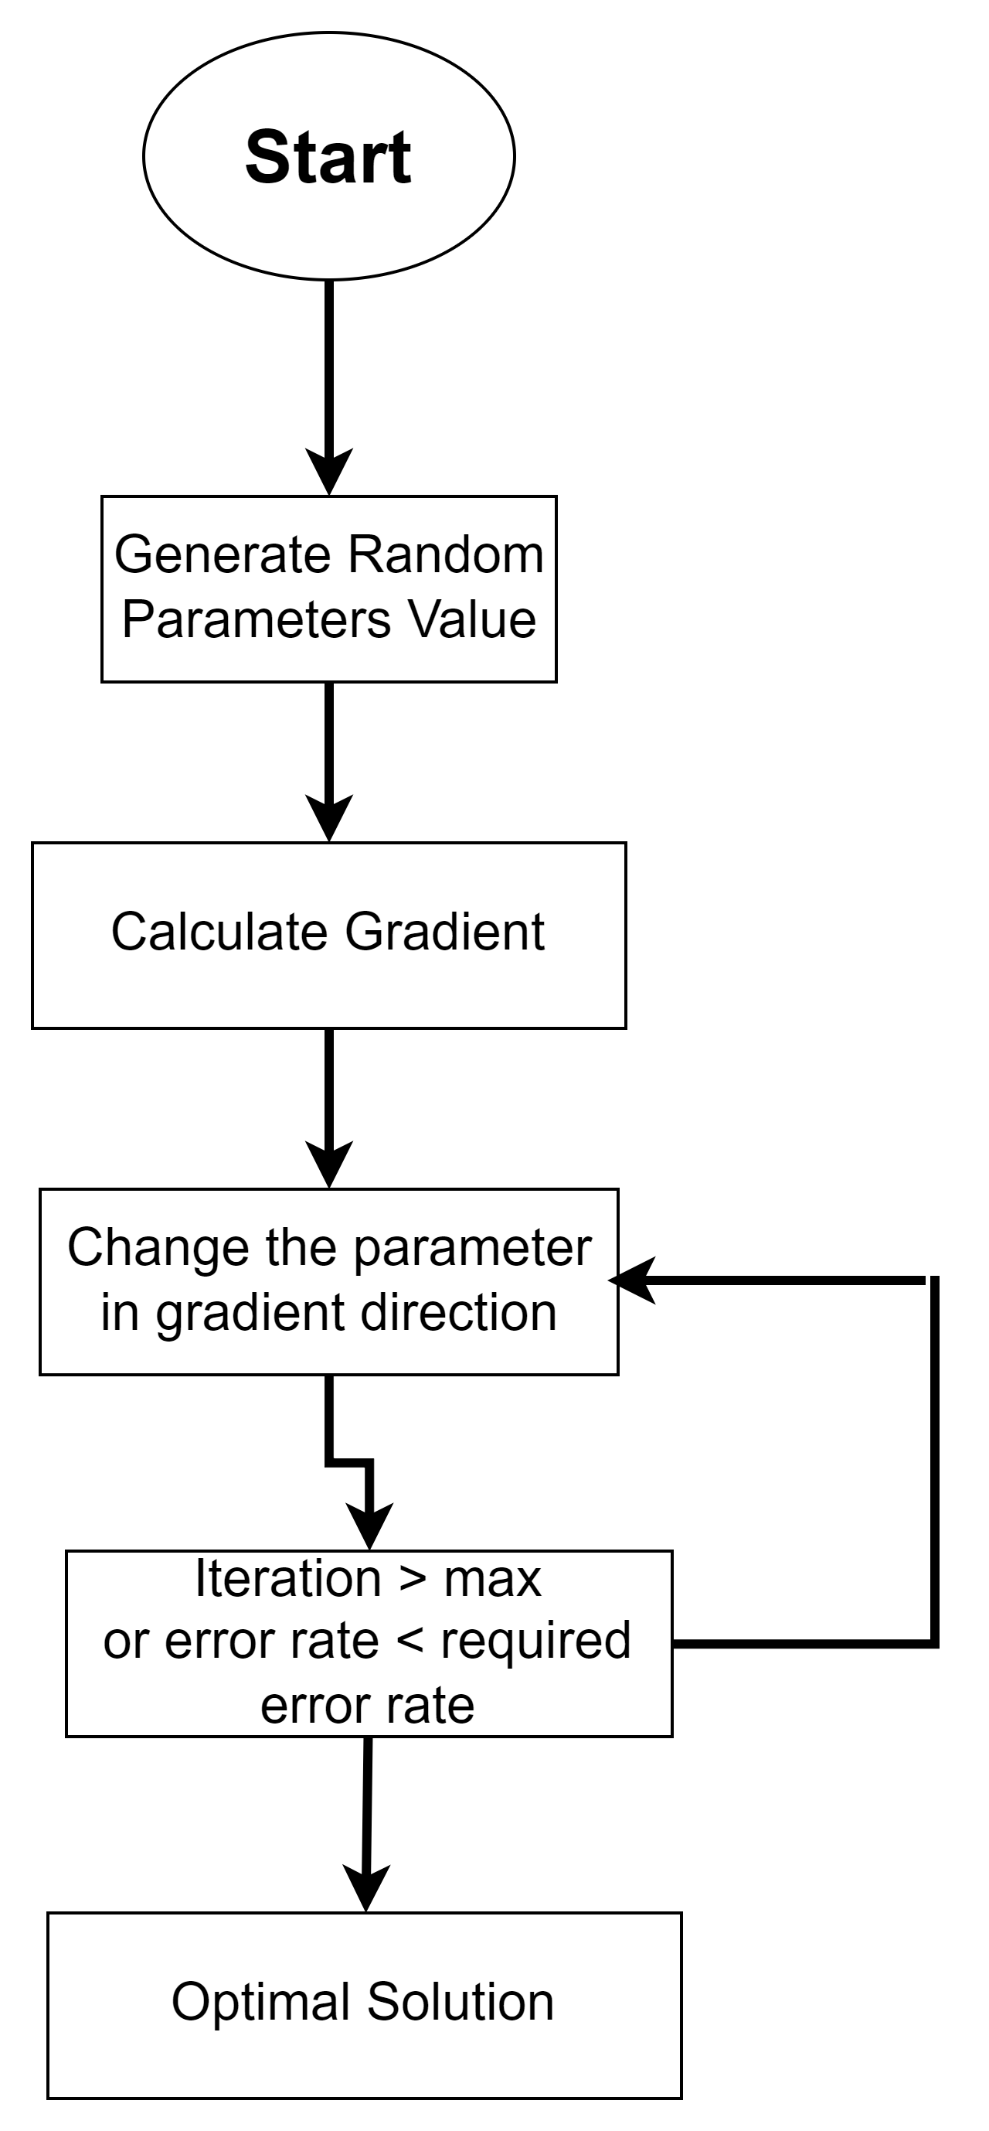
Flow Diagram of Opimization

Slide 5
GRADIENT DESCENT
Types of Optimization
2. STOCHASTIC GRADIENT DESCENT(SGD)

Slide 6
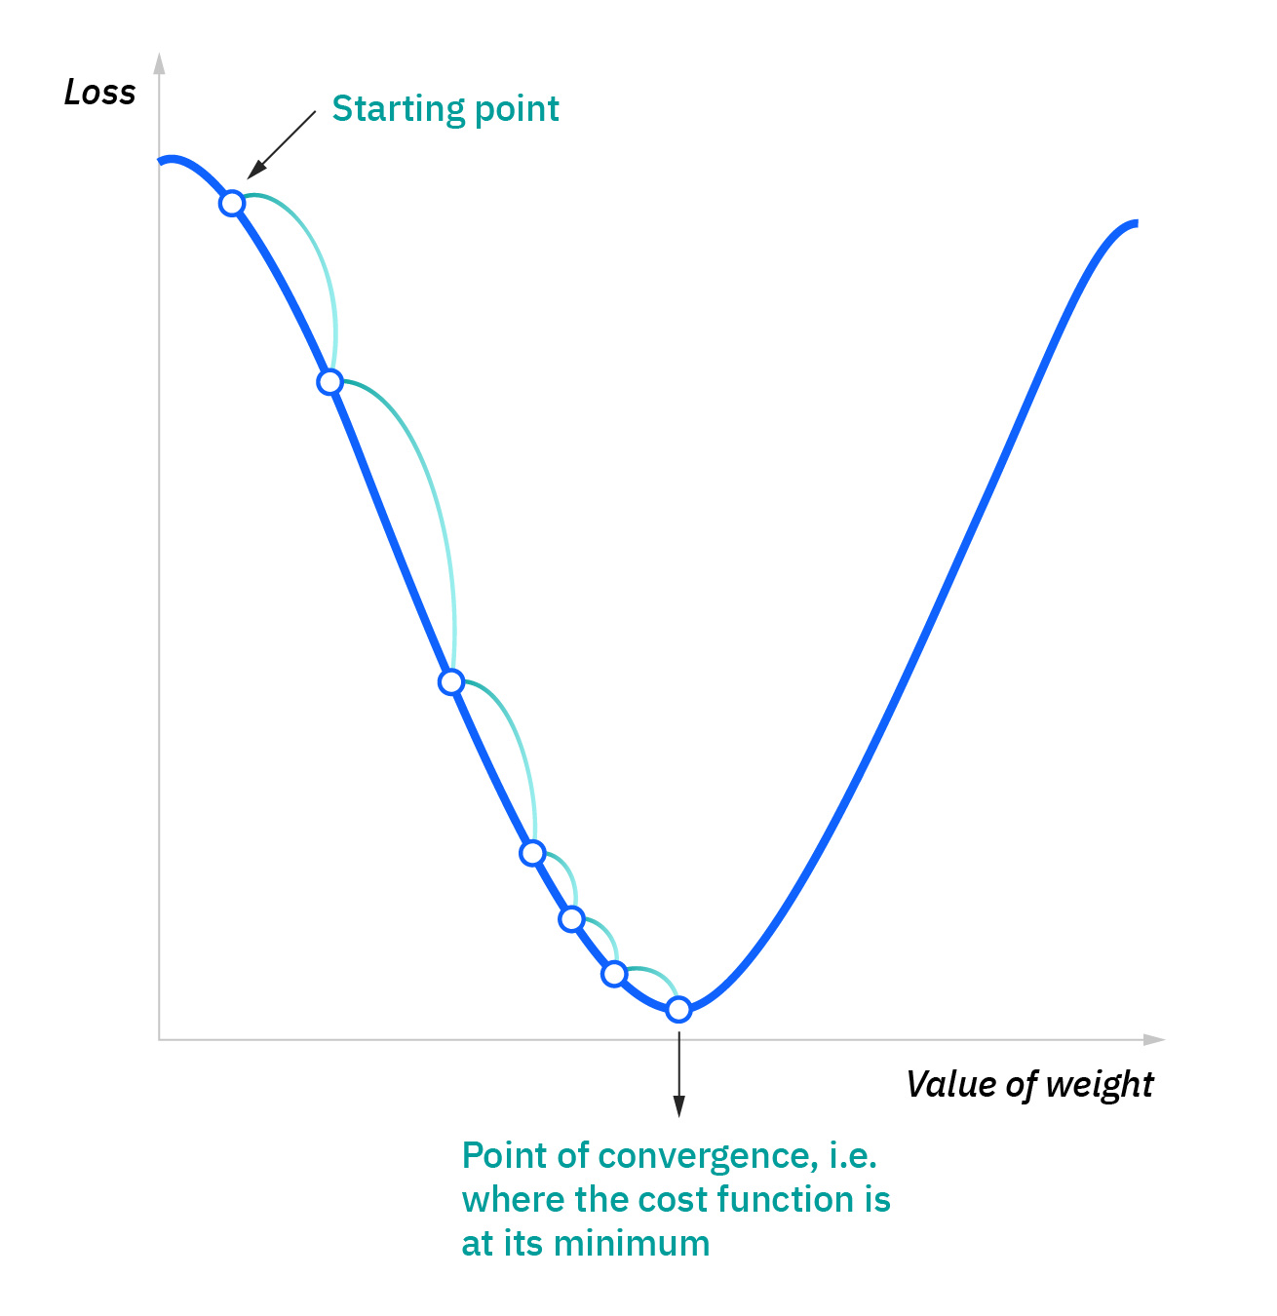
Gradient Descent Algorithm
Its a deterministic algorithm means it can determine the next step of execution beacause the path is same. Its an iterative approach to find a local minimum/maximum of a given function.
It used to find the parameter values which can minimized the cost function.

Slide 7
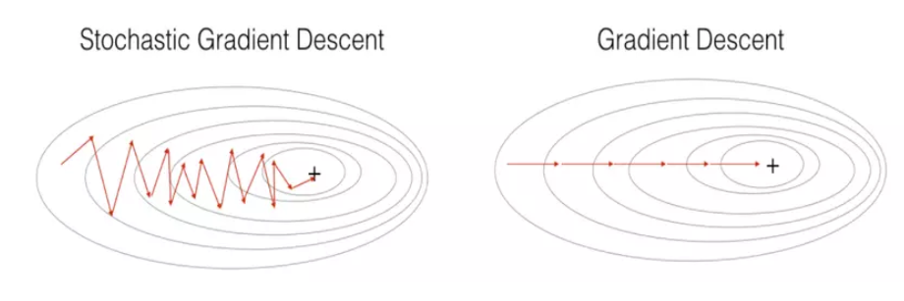
STOCHASTIC GRADIENT DESCENT(SGD)
We do not use all the data points but a sample of it to calculate the local minimum of the function, So we select points randomly from the population.
It take much lesser time on large data points then a gradient descent algorithm.
SGD
GD

Slide 8
Basically its a technique to minimize the cost function by adjusting network’s weights and biases.
Backpropagation Algorithm
Start with Initialization with random weight.
Then go to network and calculate the output via feed forwarding.
Calculate error by comparing output with actual output.
Now back-propagate to adjust weights to minimized the loss.

Slide 9
Backpropagation

Slide 10
In this network the flow of moving information or data is in one direction forward. And it dosn’t consist on loop because flow is in only forward direction.
Feed Forward Neural Network
It consist on three layers.
Input layer
Hidden layers
Output layer

Slide 11
Flow of Feed Forward Neural Network

